Slide 1
Information Extraction Using Random Forest Algorithm of Filipino Disaster-Related Tweets
John Mark D. Gabrentina

Slide 2
Significance of the Study
With many Filipino netizens sharing various types of disaster-related information in Twitter, it would be very beneficial to have a system that extracts relevant information from Twitter so they can be used to assist in disaster relief efforts.
Because of this the researcher intended to develop an Information Extraction System (IES) that will extract relevant information from Twitter. This is Filipino Disaster-Related Tweets.
However, extracting the most relevant information from Twitter is a challenge because natural languages do not have a particular structure immediately useful when programming.
Another problem that information extraction faces is that some languages, like Filipino, is morphologically rich, making it even more difficult to extract information.

Slide 3
Significance of the Study (Cont..)
In the first paper of (Imran et al, 2013), they presented a system that automatically extract information nuggets from microblogging messages during disaster times.
They used crowdsourcing as their manual classification process.
The results of their experiments indeed show that machines learning can be utilized to extract structured information nuggets from unstructured text-based microblogging messages.
In their second paper, they proposed a two-step method for disaster-related information extraction. (1) classification of tweets and (2) extraction from tweets.
The results of their second paper, which they presented a practical system that can extract disaster-relevant information from tweets, are (1) the system can detect from 40% to 80% of the tweets containing disaster related information, and generate an output that is correct 80% to 90%.
Notes:
What has been done.

Slide 4
Significance of the Study (Cont..)
The works of (Regalado et al, 2015) proposed a Filipino Information Extraction Tool (FILIET), a system that extracts relevant information from Filipino disaster-related tweets.
The author utilized the tweet categorization concept specified used in the first paper of (Imran et al, 2013).
The authors compare two algorithm for classifying tweets (i.e. K-nearest neighbors algorithm & Random forest algorithm) they made two experiments to test the algorithms.
The result of both experiment show that Random Forest Algorithm performed best, and was identified by the authors as best performance.
As the result, the author created an architecture for information extraction this is they created a rule induction, and ontology modules. And only the crawler, feature extraction, and classification modules are working.

Slide 5
Significance of the Study (Cont..)
The authors also identified there are still an issue of having a small dataset. This is attributed to the Filipinos improper use of hashtags.
And as the results, the system collected more garbage data than relevant ones.

Slide 6
Proposed Information Extraction System (IES)
Because of this the current researcher’s proposed a new Information Extraction System (IES) that will utilized the architecture presented in the paper of (Regalado et al, 2015) and the Random Forest Algorithm as the algorithm for classifying disaster related tweets.
The goal of the study is to apply an adaptive information extraction architecture that extracts information from disaster-related Filipino tweets and present them in an ontology.
The current researcher’s will change the categorization of the tweets based on the problem identified, this is because there are difference in the way Filipinos tweet from Americans.
And to extract the relevant information per category then present them in an ontology.

Slide 7
Company Profile
Sorsogon Provincial Disaster Risk Reduction Management Council (SPDRRMC)
This organization is in charge of gathering data and responsible for ensuring the protection and welfare of the people during disaster or emergencies.
SPDRRMC plans and leads the guiding activities in the field of communication, warning signals, emergency, transportation, evacuation, etc..

Slide 8
Purpose of the study
With the use of the system the organization under study help them prepare for risk management especially on disaster planning, information fro rescue and relief operation.
Enhance their communication of information, create plans with the used of the information available from the system.

Slide 9
Statement of the Problem
What are the major requirements of the proposed Information Extraction System?
What are the feature of the proposed Information Extraction System (IES)?
What is the level of usability of the proposed Information Extraction System (IES)?

Slide 10
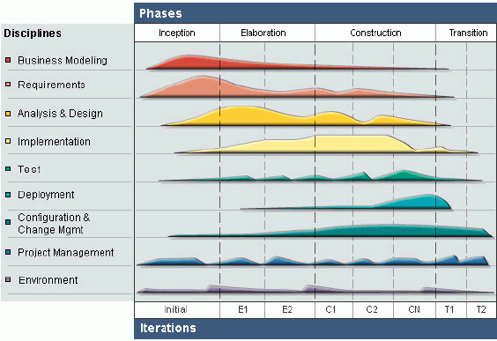
Methodology
Rational Unified Process

Slide 11
Scope of the Study
The proposed system will only be available to the Sorsogon province and its municipalities.
The system will extract disaster-related tweets from Twitter and displays them in an ontology.
The system will only extract tweets from the scope of Sorsogon province by getting the locations mentioned in the tweets or locations tag in the tweet.
The data will only be a disaster-related tweets.
The system will not extract disaster-related information from other social media platform
The system will only use data from Twitter.

Slide 12
Data gathering techniques & Sources of data
Interview
Observation
Document Analysis

Slide 13
THANK YOU

